Slide 1
MACHINE LEARNING PROJECT
PROJECT NAME: FINDING DONORS

Slide 2
TEAM MEMBERS
Name | Student Id
Nikhil Bonala | 700745888
Shreshta Gottiparthi | 700746153
Rajitha Allola | 700747104
Vinod Yadav Kannaboina | 700748732

Slide 3
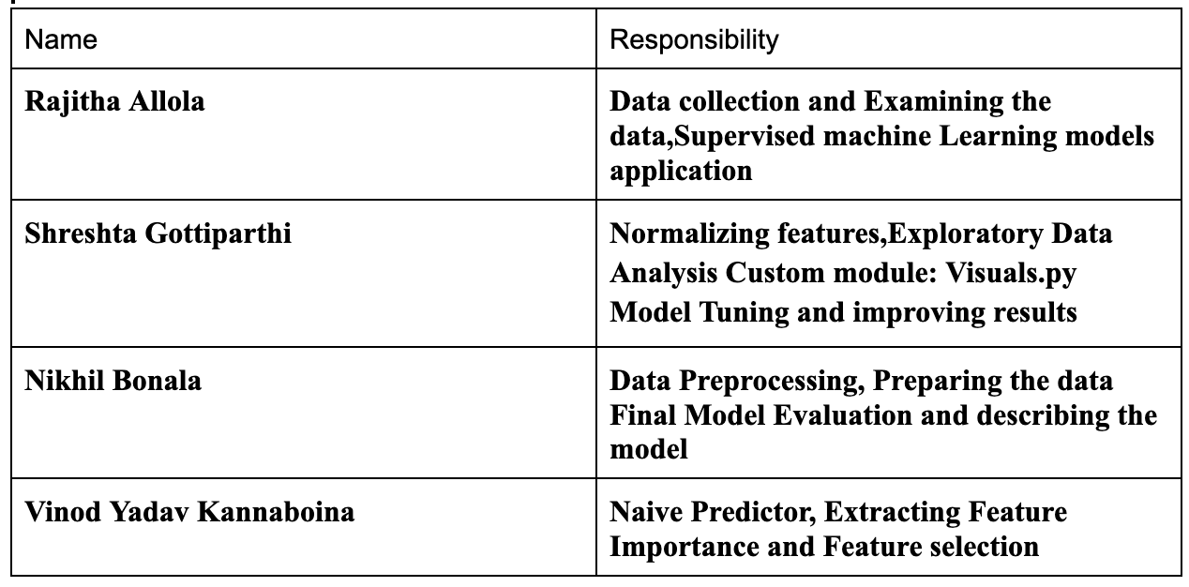
Roles and Responsibilities

Slide 4
Motivation:
Our research aims to use machine learning to help the Harry J Lloyd Charitable Trust predict donor behavior and optimize their targeted marketing strategy, reducing costs and improving their fundraising efforts.
This has broader implications for the non-profit and other sectors where targeted marketing is crucial for success.

Slide 5
Objectives
Data analysis and preprocessing for high-quality dataset
Comparison of various supervised machine learning algorithms
Optimization of targeted marketing strategy through algorithm selection
Evaluation of algorithm performance using standard metrics
Insights and recommendations for non-profit organizations

Slide 6
Related Work
Targeted marketing using machine learning has gained significant attention in recent years, with various approaches explored to predict the likelihood of an individual responding to a marketing campaign.
Decision trees and logistic regression are popular approaches, while ensemble methods like Random Forest and Gradient Boosting have shown improved performance. Deep learning techniques have also been used to extract complex patterns in data.
In the non-profit sector, targeted marketing has been used to increase donations and raise awareness for various causes. However, no study has explored machine learning techniques for the Harry J Lloyd Charitable Trust specifically, making our research significant in developing an algorithm to optimize their targeted marketing strategy.

Slide 7
Problem statement
We have a Non-profit Organization called Harry J Lloyd Charitable Trust located in Overland Park, Kansas city. In their recent survey, they found that maximum donors to the trust are earning more than 50,000 Us Dollars yearly. So the trust wanted to get more donors from all the US states and targeting state by state. We have millions of people working in the state. In order to reduce the cost of sending mail to the people who are willing to donate. We are building a Machine Learning algorithm. And the goal is to optimize and evaluate various supervised machine learning algorithms and consecutively determine the algorithm which provides higher donations on less number of emails.

Slide 8
Proposed Solution
The proposed solution for the project involves developing a machine learning algorithm that can predict the likelihood of an individual donating to the Harry J Lloyd Charitable Trust.
This will be achieved by analyzing and preprocessing the data collected by the trust to create a high-quality dataset. Various supervised machine learning algorithms will be evaluated to optimize the targeted marketing strategy, with the best-performing algorithm selected to reduce costs and improve campaign effectiveness.
Standard evaluation metrics will be used to measure algorithm performance, providing insights and recommendations for non-profit organizations implementing machine learning techniques for targeted marketing and fundraising efforts.
The proposed solution aims to enhance the trust's fundraising efforts, optimizing their targeted marketing strategy using machine learning techniques.

Slide 9
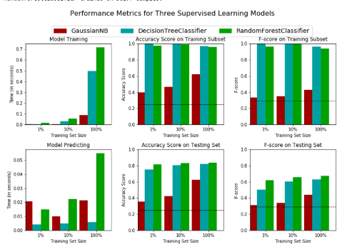
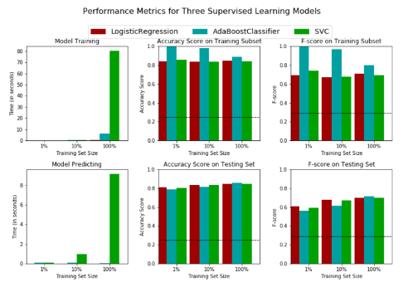
Results/Simulations
A supervised learning algorithm with feature_importance_ attribute was chosen to reduce the feature space and simplify the information required for the model to learn. Random Forest Classifier was chosen as the best model to identify individuals with an income of more than fifty thousand dollars. Decision Trees performed well in all sample sizes of training data, while Random Forest Classifier outperformed others in testing data.

Slide 10
References
N. Das and M. A. Iqbal, "Nearest Blood & Plasma Donor Finding: A Machine Learning Approach," 2020 23rd International Conference on Computer and Information Technology (ICCIT), DHAKA, Bangladesh, 2020, pp. 1-6, doi: 10.1109/ICCIT51783.2020.9392739.
[2]X. Zou, Y. Hu, Z. Tian and K. Shen, "Logistic Regression Model Optimization and Case Analysis," 2019 IEEE 7th International Conference on Computer Science and Network Technology (ICCSNT), Dalian, China, 2019, pp. 135-139, doi: 10.1109/ICCSNT47585.2019.8962457.
[3]S. Chowdhury and M. P. Schoen, "Research Paper Classification using Supervised Machine Learning Techniques," 2020 Intermountain Engineering, Technology and Computing (IETC), Orem, UT, USA, 2020, pp. 1-6, doi: 10.1109/IETC47856.2020.9249211.
[4]K. Taunk, S. De, S. Verma and A. Swetapadma, "A Brief Review of Nearest Neighbor Algorithm for Learning and Classification," 2019 International Conference on Intelligent Computing and Control Systems (ICCS), Madurai, India, 2019, pp. 1255-1260, doi: 10.1109/ICCS45141.2019.9065747.
[5]Y. Zhang et al., "Research and Application of AdaBoost Algorithm Based on SVM," 2019 IEEE 8th Joint International Information Technology and Artificial Intelligence Conference (ITAIC), Chongqing, China, 2019, pp. 662-666, doi: 10.1109/ITAIC.2019.8785556.
[6]Kim, Sang-Woon & Gil, Joon-Min. (2019). Research paper classification systems based on TF-IDF and LDA schemes. Human-centric Computing and Information Sciences. 9. 10.1186/s13673-019-0192-7.

